Slide 1
Digital Portfolio
STUDENT NAME: Santhosh Samuel F
REGISTER NO AND NMID: 2426J0327 / asbrubl24usit047
DEPARTMENT: Computer Science / Bsc. Information Technology
COLLEGE: United College of Arts and Science

Slide 2
PROJECT TITLE ONLINE LEARNING PLATFORM WITH ADAPTIVE UI

Slide 3
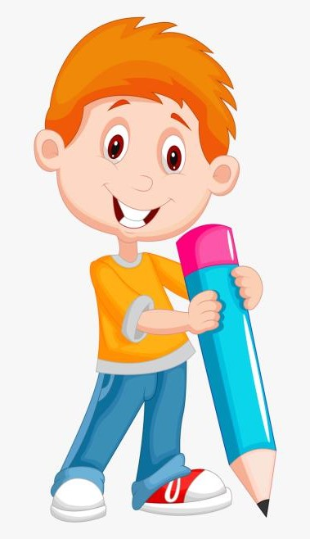

AGENDA
Problem Statement
Project Overview
End Users
Tools and Technologies
Portfolio design and Layout
Features and Functionality
Results and Screenshots
Conclusion
Github Link
3/21/2024 Annual Review

Slide 4

PROBLEM STATEMENT • Most online learning platforms use a static, one-size-fits-all UI. • Lack of personalization leads to low engagement and poor learning results. • Accessibility issues make it harder for diverse learners (like those with visual, physical, or language differences) to benefit. In short: Current platforms don’t adapt to different learners’ needs, which reduces effectiveness.

Slide 5

PROJECT OVERVIEW • The project is an Online Learning Platform with Adaptive UI. • It focuses on providing a personalized and flexible interface for each learner. • The system adapts based on user’s learning speed, preferences, and progress. • The main aim is to improve engagement, accessibility, and learning outcomes for students.

Slide 6
WHO ARE THE END USERS? • Students – school, college, and self-learners. • Teachers/Instructors – to create courses and track student progress. • Educational Institutions – schools, colleges, and training centers. • Corporate Learners/Trainers – for professional skill development.

Slide 7

TOOLS AND TECHNIQUES • Frontend: HTML, CSS, JavaScript (for building the platform interface). • Backend: Node.js (to handle server requests and data). • Database: MongoDB (to store student info and course progress). • Adaptive System: Simple Machine Learning (to adjust the UI based on learner needs). • Hosting: Cloud platforms (like AWS or Google Cloud, to make the app accessible online).

Slide 8
PORTFOLIO DESIGN AND LAYOUT
• Clean and simple design → easy to use for all learners. • Responsive layout → works smoothly on mobile, tablet, and desktop. • Student & teacher dashboards → track progress, courses, and activities. • Adaptive UI elements → adjust font size, colors, and content based on user needs.
8

Slide 9
FEATURES AND FUNCTIONALITY • Adaptive UI → changes based on each learner’s profile and progress. • Interactive courses → quizzes, assignments, and discussions. • Progress tracking → dashboards for students and teachers. • AI-based recommendations → suggest courses and resources. • Accessibility support → multiple languages, adjustable fonts, and color themes.

Slide 10

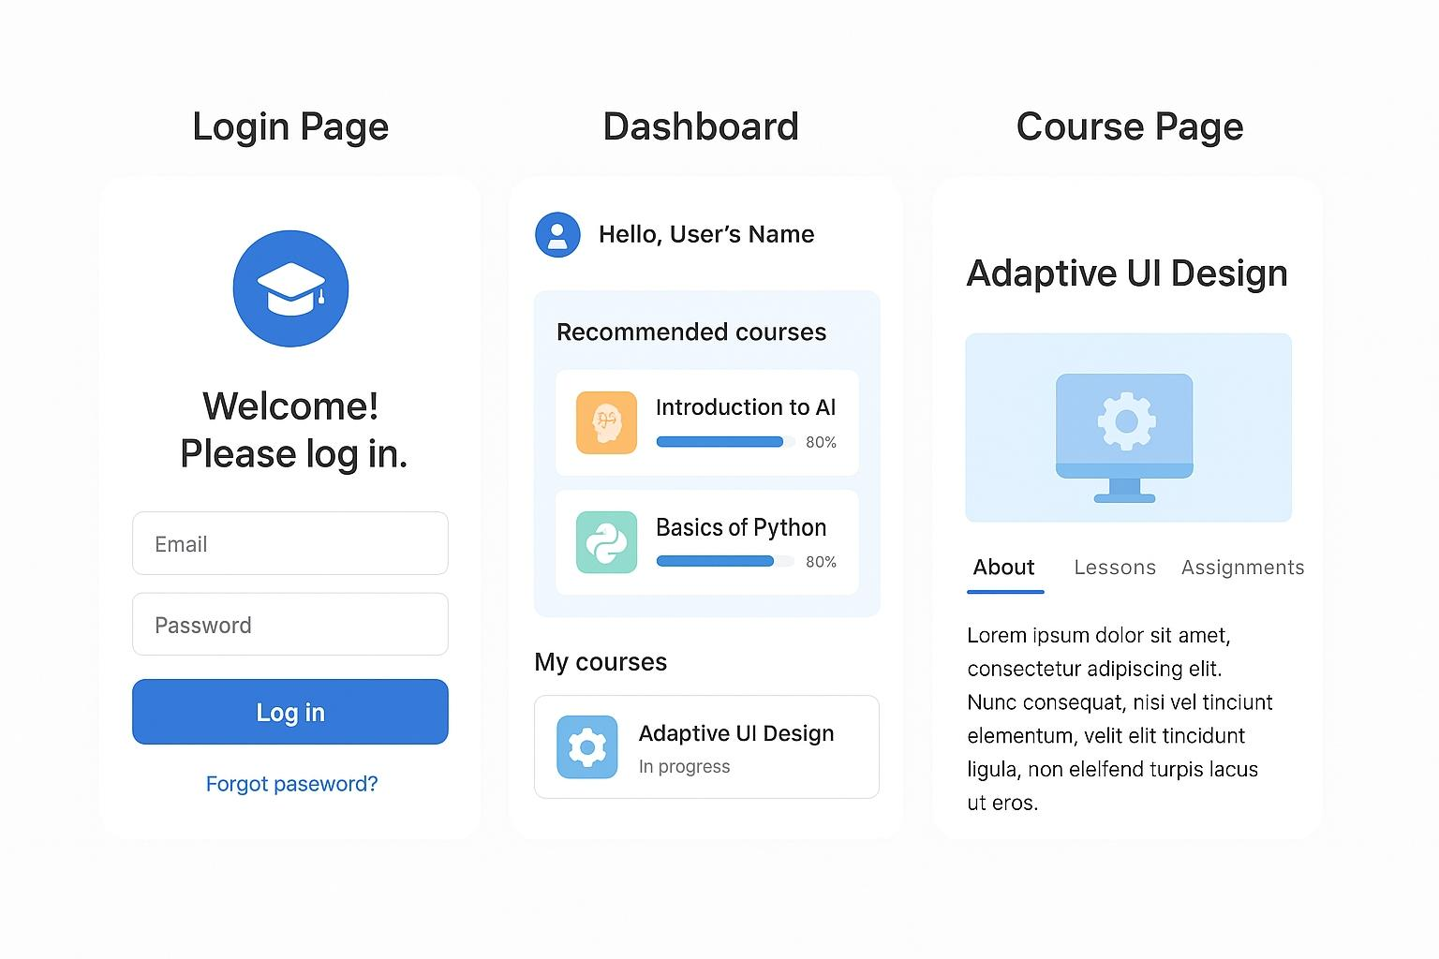
RESULTS AND SCREENSHOTS • Prototype demonstrates a working adaptive UI. • Test users reported better engagement and easier navigation. • Shows personalized dashboards and course recommendations.
3/21/2024 Annual Review
10

Slide 11
CONCLUSION • An adaptive UI makes online learning more personalized and effective. • Improves student engagement, accessibility, and outcomes. • Can be expanded with AI tutors, gamification, and VR classrooms in the future.
11

Slide 12
GitHub Link
https://github.com/santhoshsamuelisheree

